Slide 1
Nuclear Models

Slide 2
Nuclear Models:
Nuclear Models are developed with an aim to explain the
complex inter-relationships between nucleons when they
aggregate to form nuclei
Models make use of similarities between the nucleus and simpler systems, which are well understood mathematically.
Like any other quantum mechanical system, a nucleus also exist in its excited states. The most stable state is the ground state in which the nuclei are generally found.

Slide 3
There are two basic types of simple nuclear models
Collective model with no individual particle states. An example is the Liquid Drop Model which is the basis of the semi-empirical mass formula.
Individual particle model with nucleons in discrete energy states for example the Fermi Gas Model and the Shell Model.
The Fermi gas model exploits the analogy with of a gas of non-interacting particles and the liquid drop model that with a drop of liquid. ‘Independent’ models assume that the nucleons move independently in an overall potential. ‘Collective’ models assume that the nucleons interact strongly with each other.

Slide 4
The Liquid Drop Model treats the nucleus as a liquid. (The nuclear force is attractive unless the nucleons are squeezed close together. A similar attractive/repulsive behavior characterizes the force between molecules.)
Nuclear properties, such as the binding energy, are described in terms of volume energy, surface energy, compressibility, etc, parameters that are usually associated with a liquid.
This model has been successful in describing how a nucleus can deform and undergo fission.
The liquid drop model gives rise to the semi-empirical binding energy formula. This formula is an approximate expression for the binding energy B(Z,N) of a nucleus.

Slide 5
The shell Model emphasizes the orbits of individual nucleons in the nucleus. The Nuclear Shell Model is similar to the atomic model where electrons arrange themselves into shells around the nucleus. The atomic shell structure is due to the quantum nature of electrons and the fact that electrons are fermions. Since protons and neutrons are also fermions, the energy states of the nucleons are filled from the lowest to the highest as nucleons are added to the nucleus. In the shell model the nucleons fill each energy state with nucleons in orbitals with definite angular momentum. There are separate energy levels for protons and neutrons.
The nuclear shell model explains the existence of "magic numbers". Nuclei with magic neutron number N = 2, 8, 20, 28, 50, 82, 126 or magic proton number Z = 2, 8, 20, 28, 50, 82 have a larger binding energy per nucleon than neighboring nuclei, and when N and Z are both magic the binding energy per nucleon is especially large. This suggests a shell structure, similar to the shell structure in atomic physics, where the noble gases have especially large ionization energies.

Slide 6
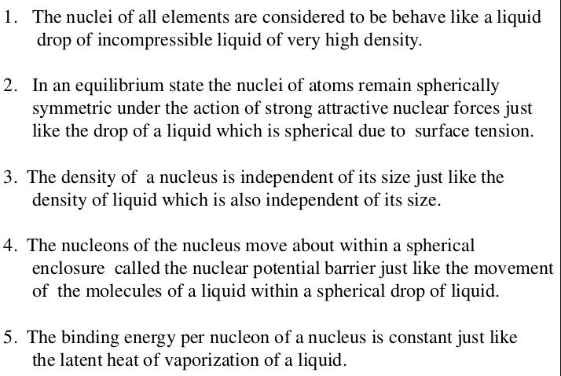
Assumptions of Liquid Drop Model:

